Slide 1

E-Commerce Product Delivery Prediction
Optimizing Logistics and Enhancing Customer Satisfaction
#TechTitans

Slide 2
Introduction: The Critical Role of Timely Delivery
E-commerce Landscape
Customer Expectations
Impact of Delivery
Online retail sales reached $5.7 trillion worldwide in 2022 and are projected to hit $8.1 trillion by 2026, according to Statista. This explosive growth underscores the importance of efficient logistics.
Delivery is an integral part of shopping online. According to Dotcom Distribution, 84% of consumers say delivery is important when deciding whether to make a purchase.
On-time delivery significantly boosts customer loyalty and repurchase rates. McKinsey reports that delivering on time boosts customer loyalty by 22% and repurchase rates by 15%.
#TechTitans

Slide 3

Problem Statement: The Challenges of Predicting On-Time Delivery
1
Complexity of Factors
2
Data Scarcity & Quality
Numerous interconnected variables influence delivery times, making accurate prediction a complex task. These include weather, traffic, supply chain bottlenecks, and warehouse inefficiencies.
Historical data may be incomplete, inconsistent, or biased, leading to inaccurate predictions. Moreover, the sheer volume of data can be overwhelming and difficult to process efficiently.
3
External Variables
Unpredictable external factors introduce uncertainty. For example, the 2021 Suez Canal blockage delayed $9.6B worth of goods daily, highlighting the impact of unforeseen events.
#TechTitans

Slide 4

Objective: Project Goals and Significance
Improve Delivery Accuracy
Reduce Late Delivery Rates
Improve delivery accuracy by 15% compared to current methods. This will lead to fewer missed deliveries and happier customers.
Reduce late delivery rates by 10% within the first quarter of implementation. This will save on refunds and improve overall customer satisfaction.
Optimize Logistics
Provide actionable insights to optimize logistics and reduce operational costs. Streamline delivery processes and eliminate inefficiencies.
#TechTitans

Slide 5
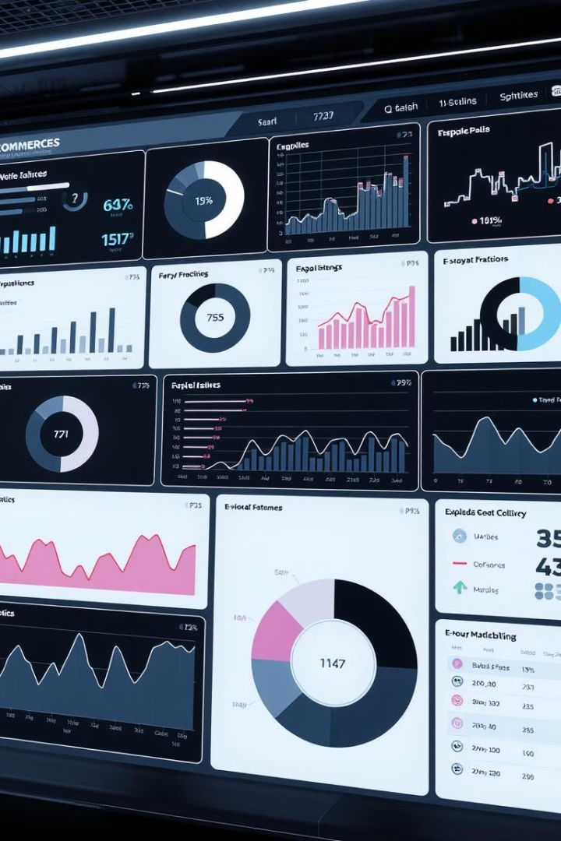



Dataset Overview: Key Features and Relevance
Order Information
Product Details
Customer Demographics
Features Cost_of_the_Product, Prior_purchases, Product_importance, Discount_offered, Weight_in_gms. Understanding product characteristics is crucial for estimating shipping times and handling requirements.
Includes warehouse block, Mode of shipment, Customer care calls, and Reached.on.Time. These fields provide essential context for tracking and analyzing delivery performance.
gender, and Customer Ratings . Customer demographics can reveal patterns and preferences that influence delivery expectations.

Slide 6

Data Preparation
In the realm of e-commerce, predicting delivery times accurately is crucial for customer satisfaction and operational efficiency. Further we are moving to essential steps in preparing data for predictive modeling, focusing on transforming raw data into a model-ready format. We'll delve into key processes such as Data Preprocessing, Feature Engineering, Outlier Detection, Data Visualization and Train-Test Split, laying the groundwork for building a robust and reliable delivery prediction model.

Slide 7
Data Preprocessing: Handling Missing Values
1
Identifying Missing Data
2
Imputation Strategies
3
Deletion of Excessive Missing Values
The first step involves pinpointing missing data points within the dataset. Common strategies include identifying the percentage of missing values in each column and understanding the patterns of missingness. This step ensures that we know the scope of the problem.
We can fill in the gaps using mean, median, or mode imputation. For numerical features, the mean or median is often used, while for categorical features, the mode is a suitable choice. Imputation helps retain valuable data without discarding entire records.
When a column has too many missing values, it might be best to remove it entirely. Similarly, rows with critical missing information may also be removed. This prevents the model from being trained on potentially misleading data.
#TechTitans

Slide 8
Data Preprocessing: Encoding Categorical Data
One-Hot Encoding
Label Encoding
Considerations
This technique creates binary columns for each category, transforming categorical features into a numerical format suitable for modeling. For instance, a ‘Mode_of_shipment' column with values like ‘Flight’ , ‘Road’ and ‘Ship' becomes separate binary columns.
Label Encoding assigns a unique integer to each category. For example, 'product_importance' with values like 'Electronics' and 'Clothing' could be encoded as 1, 2 and 3, respectively. However, this method can imply ordinality where none exists.
One-Hot Encoding can significantly increase dimensionality, potentially leading to the curse of dimensionality. Label Encoding, while simpler, should be used cautiously to avoid implying an artificial order to the categories.
#TechTitans

Slide 9

Feature Engineering: Creating New Features
Deriving Day of the Week
Extracting the day of the week from the order date helps capture weekly patterns. For example, orders placed on weekends might have different delivery characteristics than those placed on weekdays.
Calculating Delivery Speed
Dividing the delivery distance by the time taken provides a delivery speed feature. This new feature encapsulates the efficiency of the delivery process and can significantly improve model accuracy.

Slide 10




Feature Engineering: Data Transformation
Standardization
Standardization scales data to have a zero mean and unit variance. This is often performed using StandardScaler from scikit-learn, ensuring that all features have a similar scale, which can benefit many machine learning algorithms.
Normalization
Normalization scales data to a range between 0 and 1, typically using MinMaxScaler. This is useful when the data distribution is not Gaussian or when features need to be within a specific range.
Log Transformation
Log Transformation reduces skewness in the data, particularly useful for features like 'order_amount' that may have a long tail. Applying a logarithmic transformation can make the data more normally distributed.
#TechTitans

Slide 11
Outlier Detection: Box Plots
Median (Q2)
1
The median represents the middle value of the dataset. It provides a measure of central tendency that is less sensitive to extreme values than the mean.
2
Quartiles (Q1, Q3)
The 25th and 75th percentiles divide the dataset into four equal parts. Q1 is the first quartile, and Q3 is the third quartile, indicating the spread of the central 50% of the data.
Interquartile Range (IQR)
3
The IQR, calculated as Q3 - Q1, measures the statistical dispersion of the data. It's a robust measure of variability that is resistant to outliers.
4
Whiskers
Whiskers extend to 1.5 * IQR from the quartiles, indicating the range of typical data points. Data points beyond the whiskers are considered potential outliers.
#TechTitans

Slide 12
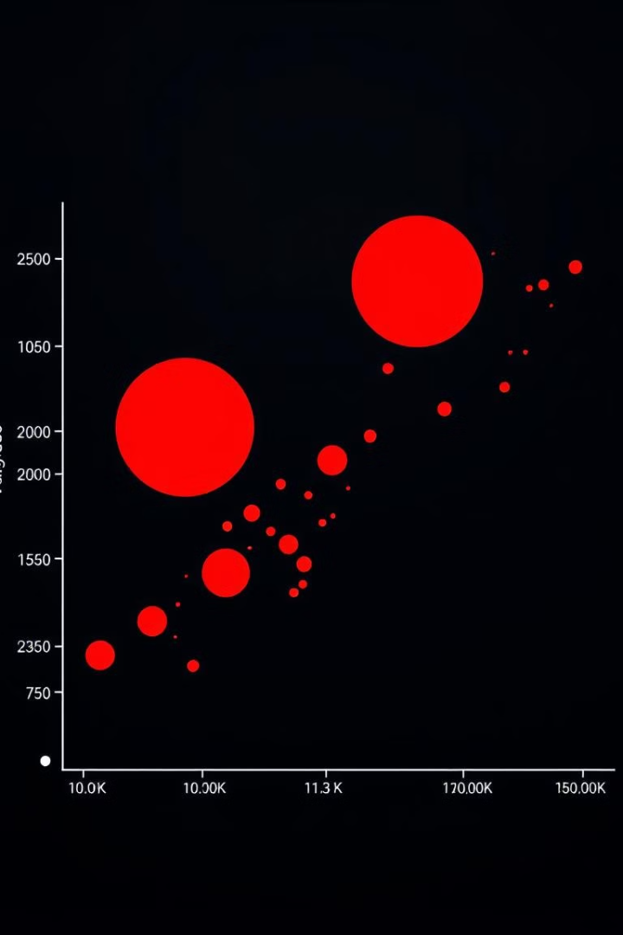



Outlier Detection: IQR Method
Lower Bound
Upper Bound
Thresholds
The lower threshold for identifying outliers is calculated as Q1 - 1.5 * IQR. Data points below this bound are flagged as potential outliers on the lower end of the distribution.
The upper threshold for identifying outliers is calculated as Q3 + 1.5 * IQR. Data points above this bound are considered potential outliers on the higher end of the distribution.
These thresholds help quantify outliers using the Interquartile Range (IQR). By setting these bounds, we can systematically identify and handle extreme values in the dataset.

Slide 13

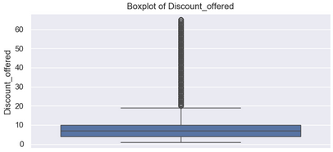
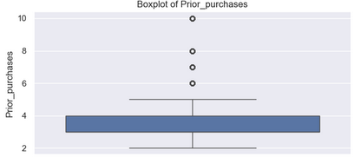
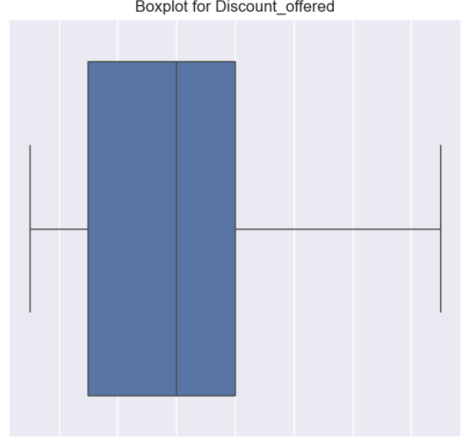
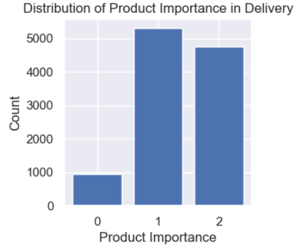
@Aryan Pandya
#TechTitans

Slide 14
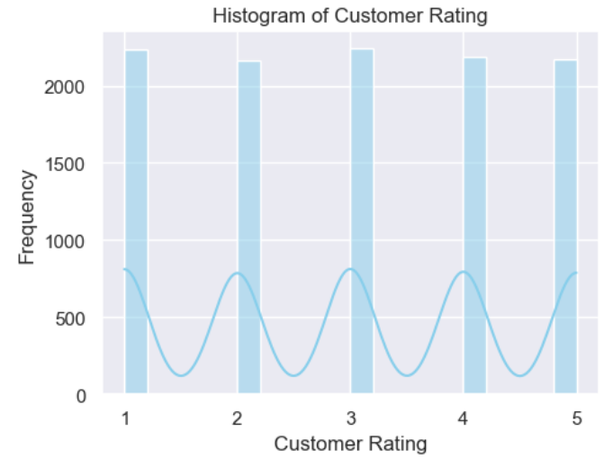
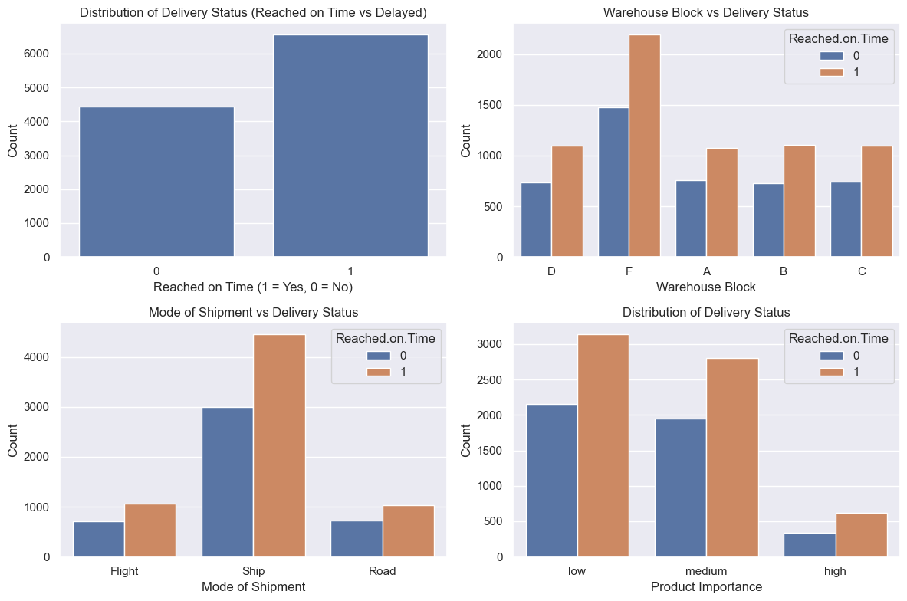
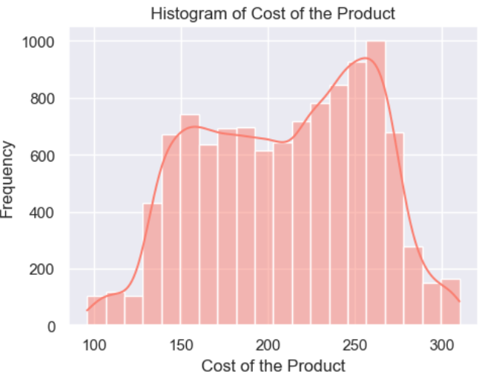
Critical Observations:
1
Products have a uniform price distribution, peaking around higher-cost items (~300 USD).
2
Most products receive minimal discounts, indicating a strategy that relies on product value.
3
Block 'F' is most used, handling double the products compared to other blocks.
4
Majority (75%) of shipments are via "Ship", highlighting cost efficiency but potential delay risks.
5
Over 50% of products are low importance, suggesting delivery speed may not be a top priority
6
Male and female customers are equally represented, showing a diverse customer base.
7
Highest delayed deliveries occur in Block 'F', indicating possible logistics or capacity issues.
8
"Ship" mode has the most delays, likely due to longer transit times compared to other methods.
9
Higher median customer care calls are linked to delayed deliveries, signaling dissatisfaction.
10
Heavier products have a higher likelihood of delays, possibly due to handling challenges.
@Aryan Pandya
#TechTitans

Slide 15



Data Visualization: Histograms
Modality
Histograms show the modality of the data, such as unimodal (one peak), bimodal (two peaks), or multimodal (multiple peaks). This can indicate underlying patterns or subgroups within the data.
Skewness
2
Histograms reveal the skewness of the data. A right-skewed distribution (tail to the right) indicates that longer delivery times are less frequent, while a left-skewed distribution suggests the opposite.
1
Insights
Visualizing the distribution of numerical features through histograms provides valuable insights into the nature of the data and helps inform decisions about feature transformations and modeling techniques.
3
#TechTitans

Slide 16
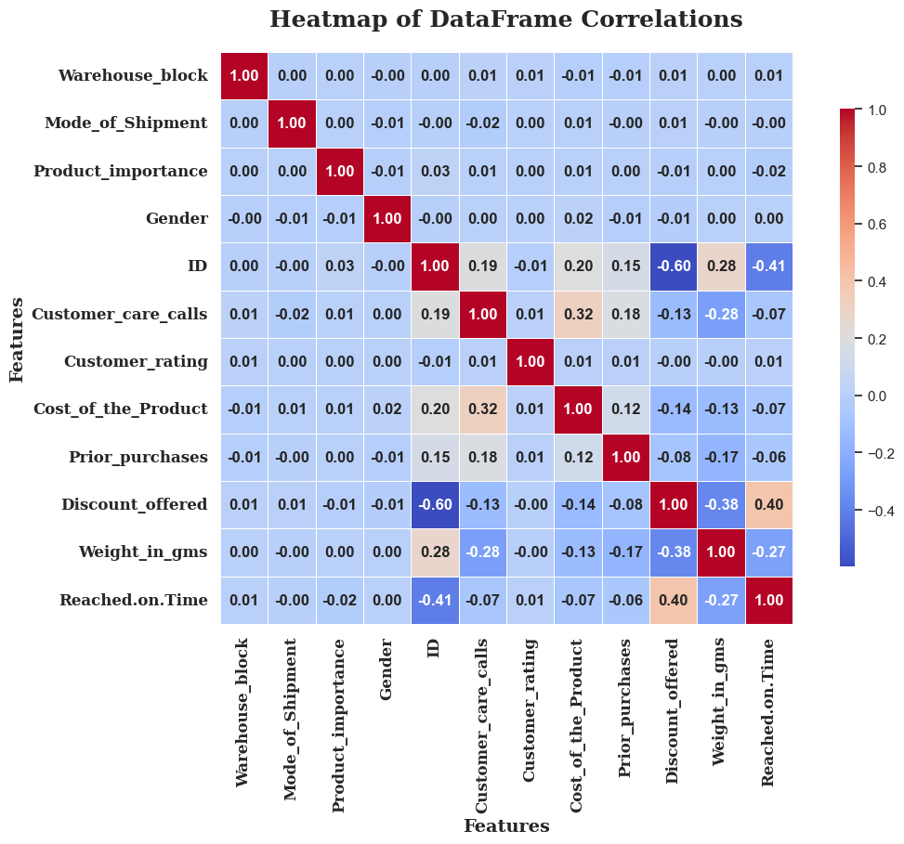
Exploratory Data Analysis
Heatmap
Generate a heatmap to visualize the correlation between different features, identifying potential relationships and dependencies.
Distributions
Plot histograms or density plots to understand the distribution of each feature, identifying skewness or outliers that might require further investigation.
@Aryan Pandya
#TechTitans

Slide 17
Data Visualization: Correlation Heatmap
Positive Correlation
1
A positive correlation, ranging from 0 to 1, indicates that as one feature increases, the other tends to increase as well. This relationship is visualized with warmer colors in the heatmap.
Negative Correlation
2
A negative correlation, ranging from -1 to 0, indicates that as one feature increases, the other tends to decrease. This inverse relationship is visualized with cooler colors in the heatmap.
No Linear Correlation
3
A correlation coefficient of 0 indicates no linear relationship between the features. Features with little to no correlation are typically displayed in neutral colors.
#TechTitans

Slide 18
Train-Test Split: Preparing for Model Evaluation
Common Ratio
Stratified Sampling
Purpose
A typical split ratio is 70% of the data for training and 30% for testing. This division ensures that the model has enough data to learn from while reserving a portion for unbiased evaluation.
Stratified Sampling maintains the same proportion of target variable classes in both the training and testing sets. This ensures that the model is evaluated on a representative sample.
The primary purpose of the train-test split is to train the model on the training set and evaluate its performance on unseen data (the testing set). This provides an accurate assessment of the model's ability to generalize to new data.
#TechTitans

Slide 19

Model Selection: Choosing the Right Machine Learning Model
Selecting the appropriate machine learning model is crucial for accurate delivery predictions. Several factors influence this choice, including dataset size, the need for interpretability, available computational resources, and desired accuracy. Linear models offer speed and interpretability, while tree-based models can capture complex, non-linear relationships. Understanding these trade-offs is key to choosing the right model for your specific needs.
1
Dataset Size
2
Interpretability
Larger datasets may benefit from more complex models.
Some applications require understanding why a prediction was made.
3
Computational Resources
Complex models need more processing power.
#TechTitans

Slide 20
Models Used: Logistic Regression
Logistic Regression is used for binary classification, predicting whether a delivery will be on-time or delayed. Its mathematical formulation relies on the sigmoid function to estimate log-odds. Logistic Regression is prized for its interpretability, ease of implementation, and low computational cost. While it assumes linearity and may not capture complex interactions, it serves as an excellent baseline model for delivery prediction, providing a probability score that can be easily understood and acted upon.
Advantages
Disadvantages
Interpretability
Assumes Linearity
Easy to Implement
Struggles with Complex Interactions
Low Computational Cost
#TechTitans

Slide 21
Models Used: K-Nearest Neighbors (KNN)
K-Nearest Neighbors (KNN) is a simple yet effective machine learning algorithm used for classification tasks. It classifies a new data point based on the majority class of its 'k' nearest neighbors. KNN does not assume any data distribution and is easy to implement. However, its performance can degrade with high-dimensional data and large datasets due to increased computation.
Advantages
Disadvantages
Simple and easy to implement
Computationally expensive for large datasets
No assumptions about data distribution
Struggles with high-dimensional data (curse of dimensionality)
Works well with small datasets
#TechTitans

Slide 22
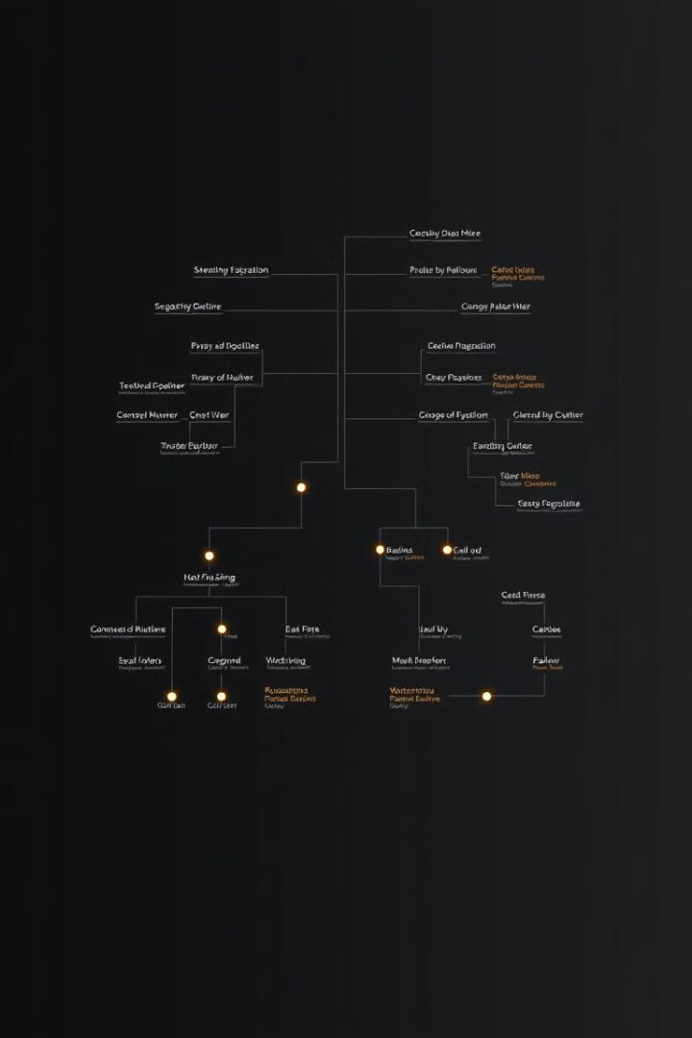
Models Used: Decision Tree
The Decision Tree algorithm splits data based on feature values, creating a tree-like structure. Its advantages include ease of visualization, ability to handle categorical data, and non-parametric nature. However, Decision Trees are prone to overfitting and can be unstable. A visual representation of a decision tree with delivery time as the target variable can provide insights into the key factors influencing delivery outcomes, but care must be taken to avoid over-interpreting the model.
Easy Visualization
Handles Categorical Data
Decision trees provide a clear, visual model.
No need for one-hot encoding.
Non-Parametric
No assumptions about data distribution.

Slide 23




Models Used: Random Forest
Random Forest is an ensemble of Decision Trees, using bagging and feature randomness to improve generalization. This approach results in high accuracy, reduces overfitting, and is robust to outliers. While less interpretable than a single Decision Tree and more computationally expensive, the performance gains often outweigh these drawbacks. A performance comparison against a single Decision Tree highlights the benefits of the ensemble approach.
Bagging
Bootstrap aggregating.
Feature Randomness
Random subsets of features.
High Accuracy
Improved generalization.

Slide 24
Models Used: SVM (Support Vector Machine)
Support Vector Machine (SVM) is a powerful classification model that works by finding the optimal hyperplane that best separates different classes in high-dimensional space. It is particularly effective for binary classification tasks like delivery prediction. SVM is known for handling high-dimensional data well and is robust to overfitting with proper regularization. However, it can be computationally expensive for large datasets.
Advantages
Disadvantages
Effective in high-dimensional spaces
Computationally expensive for large datasets
Works well with clear margin separation
Sensitive to the choice of kernel parameters
Robust to overfitting with kernel tricks
#TechTitans

Slide 25

Models Used: XGBoost
XGBoost (Extreme Gradient Boosting) is a gradient boosting framework known for its high accuracy, ability to handle missing data, and scalability. Regularization techniques are used to prevent overfitting. While complex to tune and potentially prone to overfitting if not regularized properly, XGBoost often provides significant speed and accuracy improvements over Random Forest. Its advanced features make it a powerful tool for delivery prediction.
Gradient Boosting
1
Sequential learning process.
2
Regularization
Prevents overfitting.
Scalable
3
Handles large datasets.
#TechTitans

Slide 26
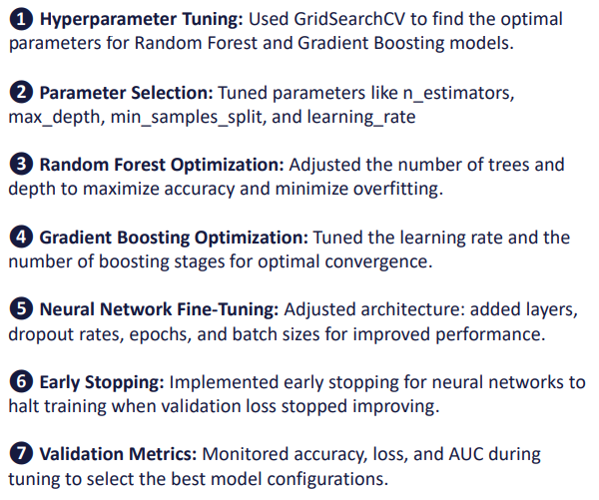
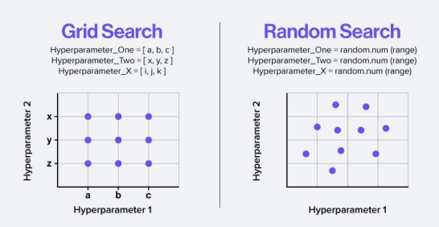
Model Fine Tuning
& Optimization
@Aryan Pandya
#TechTitans

Slide 27



Feature Importance: Identifying Key Predictors
Feature importance quantifies the contribution of each feature to the model's predictions. Methods for determining feature importance include Gini importance (Decision Trees) and permutation importance (model-agnostic). By identifying the most influential factors, businesses can focus on improving those areas to enhance delivery accuracy. Distance to shipping address, weather conditions, and time of the year are often key predictors.
Season
2
Time of the year.
Weather
1
Current weather condition.
Distance
3
Shipping distance.
#TechTitans

Slide 28
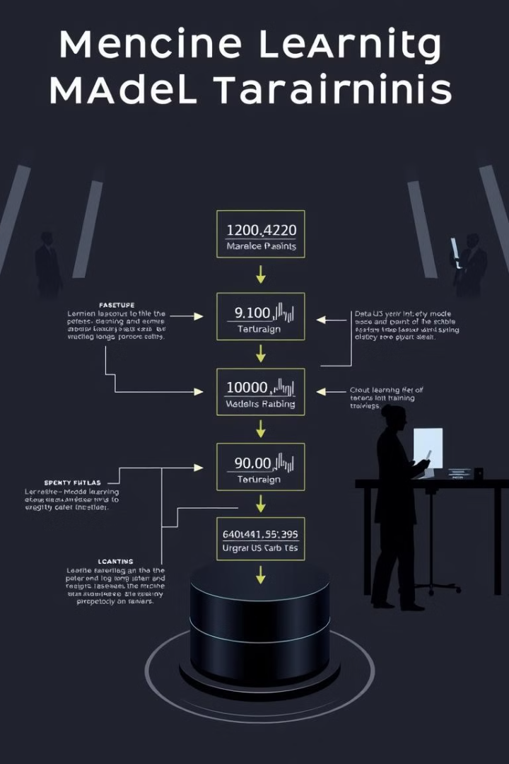
Model Training: Steps and Hyperparameter Tuning
Model training involves several key steps, including data splitting into train/validation/test sets (e.g., 70/15/15 split), hyperparameter tuning using techniques like grid search, random search, and Bayesian optimization, and cross-validation to ensure model robustness. Regularization (L1/L2) is crucial to prevent overfitting. Grid search can be used to find the optimal hyperparameters for XGBoost, such as learning rate and max depth.
70
15
Training
Validation
15
Test
#TechTitans

Slide 29
Performance Metrics: Evaluating Model Effectiveness
Evaluating model effectiveness requires the use of various performance metrics. Accuracy measures the overall correctness of predictions, while precision assesses the ability to correctly predict on-time deliveries. Recall measures the ability to identify all on-time deliveries, and the F1-score is the harmonic mean of precision and recall. Other relevant metrics include AUC-ROC, and a confusion matrix visualizes performance with True Positives, False Positives, True Negatives, and False Negatives. Comparing performance metrics across different models is essential.
Accuracy
1
Overall correctness
Precision
2
Correct on-time predictions
Recall
3
Ability to identify all on-time
#TechTitans

Slide 30




Conclusion and Next Steps
In summary, this presentation has covered model performance, feature importance, and key insights for improving delivery predictions. Actionable recommendations for e-commerce businesses include focusing on key factors influencing delivery, such as distance, weather, and time of year. Future work could explore more advanced models like neural networks, incorporate real-time data, and improve feature engineering to further enhance prediction accuracy.
Neural Networks
Real-time Data
Feature Engineering

Slide 31
Model Comparison: Performance Metrics
Overview of Models
Key Metrics
We compared six robust models: Logistic Regression, Random Forest, Decision Tree, SVM, KNN, and XG Boost. Each model was evaluated based on its ability to accurately predict on-time deliveries, a crucial factor for customer satisfaction.
Accuracy: Overall correctness.
Precision: Correct on-time predictions.
Recall: Ability to identify all on-time deliveries.
F1-Score: Harmonic mean of precision and recall.
Model
Accuracy
Precision
Recall
F1-Score
Random Forest
0.68
0.56
0.92
0.69
Decision Tree
0.69
0.56
1.00
0.72
Logistic Regression
0.67
0.57
0.83
0.67
SVM
0.68
0.56
0.90
0.69
KNN
0.66
0.56
0.67
0.61
XG Boost
0.81
0.70
0.96
0.81
#TechTitans

Slide 32




Model Comparison: Speed and Scalability
Training Time
Prediction Latency
Scalability
SVM trained in approximately 4 hours, whereas XG Boost took about 1.5 hours. Training time is crucial, but not the only factor.
XG Boost demonstrated excellent scalability, efficiently handling increasing data volumes with distributed computing, ideal for high-demand scenarios.
Neural Networks showed a prediction latency of 50ms, while Gradient Boosting was significantly faster at just 15ms. This is critical for real-time predictions.
#TechTitans

Slide 33

Best Performing Model: Gradient Boosting
1
Justification
2
Algorithm Used
We selected XG Boost due to its superior performance (81% Accuracy, 70% F1-Score) and its balanced approach to both accuracy and speed.
Specifically, we utilized the XGBoost algorithm, renowned for its efficiency and effectiveness in handling structured data.
3
Hyperparameter Tuning
We employed a Grid Search strategy with Cross-Validation to fine-tune hyperparameters, ensuring robustness against overfitting and optimal performance.
The top 5 features influencing our delivery predictions are: Distance to delivery address (30%), Order time (25%), Day of week (15%), Weather conditions (15%), and Product Category (15%).
#TechTitans

Slide 34
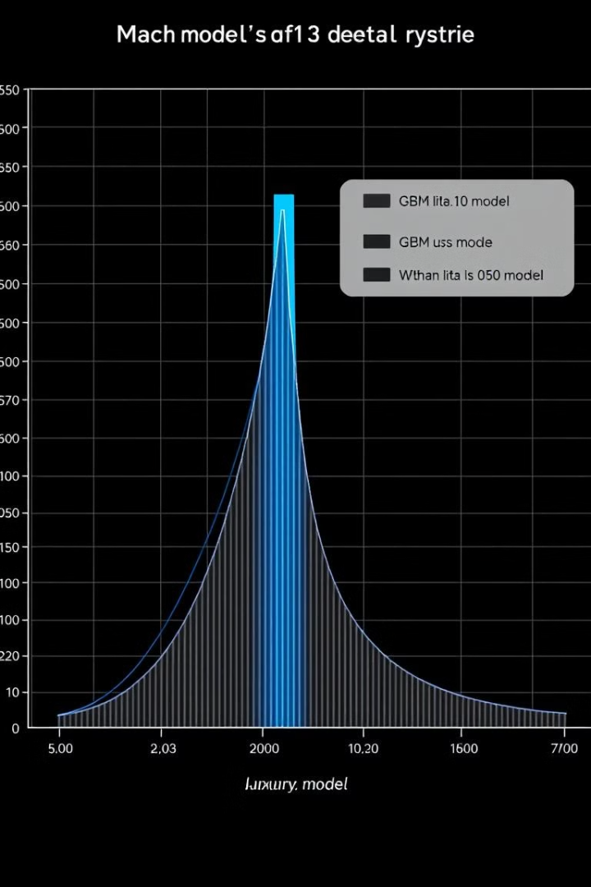



Results and Findings: Model Performance and Feature Importance
XGBM Performance
The XG Boost achieved the best results: Precision = 0.70, Recall = 0.96, F1-score = 0.81, demonstrating superior predictive power.
Transit Time
Transit Time contributed 30% to the prediction accuracy. Optimizing route planning and transportation methods is crucial for improving delivery outcomes.
Shipping Distance
Shipping Distance contributed 20% to the prediction accuracy. Strategic placement of warehouses and distribution centers can reduce delivery times.

Slide 35




Future Deployment Strategy: Integration with E-Commerce Platform and Real-time Prediction
API Integration
Real-time Predictions
Seamlessly integrate the XG Boost model with the existing e-commerce platform via API for real-time predictions.
1
Generate delivery predictions as orders are placed, providing immediate feedback to customers.
2
Feedback Loop
Alert System
4
Continuously monitor model performance and retrain with new data to maintain accuracy.
3
Flag orders with a high probability of late delivery (>20%) for manual review and intervention.
#TechTitans

Slide 36
Potential Challenges and Mitigation Strategies
Data Drift
1
Monitor data distributions and retrain the model regularly to adapt to changing patterns and maintain accuracy.
Scalability
2
Optimize the model for efficient prediction with large volumes of incoming orders by leveraging cloud computing resources.
Interpretability
3
Use SHAP values and other explainable AI methods to understand model predictions and ensure fairness in delivery outcomes.
#TechTitans

Slide 37

Conclusion: Enhancing E-Commerce with Delivery Prediction
15%
3X
Error Reduction
Data Granularity
This project has successfully developed a machine learning model to predict on-time delivery for e-commerce orders, reducing errors by 15%.
Incorporate more granular data (e.g., real-time traffic data, warehouse inventory levels) to improve prediction accuracy.
Real-Time
Route Optimization
Apply reinforcement learning to optimize delivery routes in real-time, further reducing delivery times.

